Slide 1


HARDWARE AND
NETWORKING
Submitted by
J. Sai Pavan

Slide 2
Computer network
Computer network • A computer network is a system of interconnected computers and peripheral devices.
• For example, it may connect computers, printers, scanners and cameras.

Slide 3
Communications
Communications is about the transfer of information from a sender, across a distance, to a receiver.
• Communication is an act of transmitting messages

Slide 4
Computer network communication
• We transmit information or data by using two types of signals, namely analog and digital.
• Computers communicate with digital signals.
• The older forms of communications technology, such as telephones and radios, use analog signals.

Slide 5
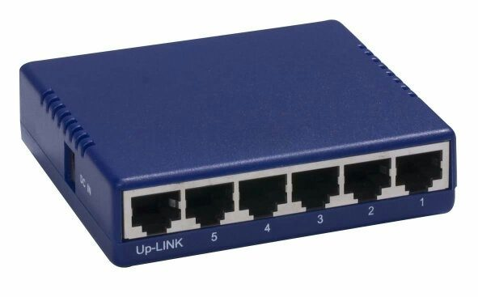
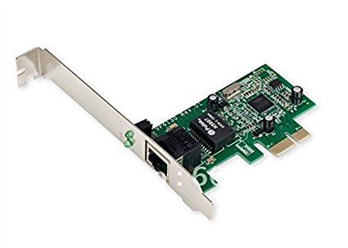
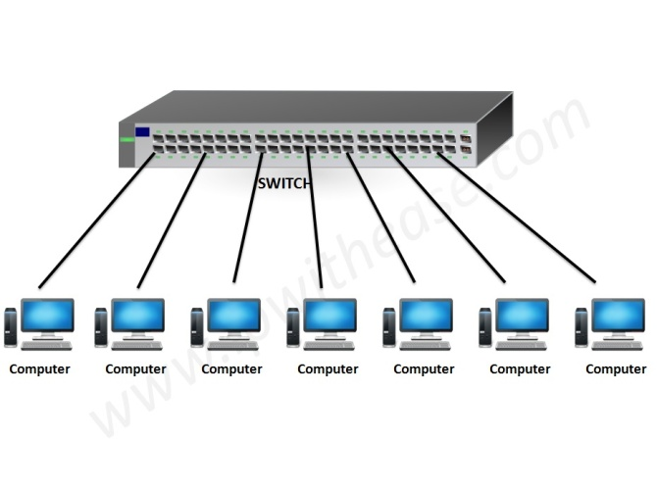
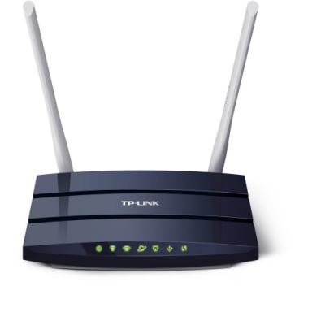
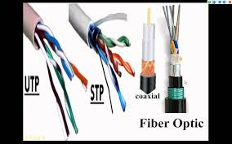
NETWORKING DEVICES
LAN CARD
HUBS
SWITCHES
ROUTERS
CABLES

Slide 6
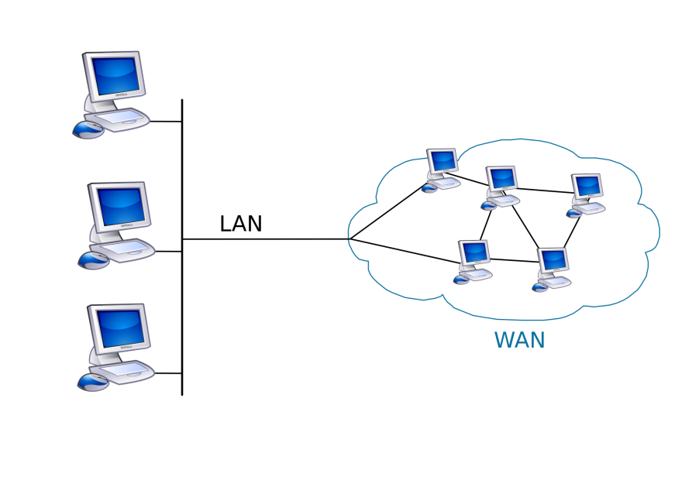
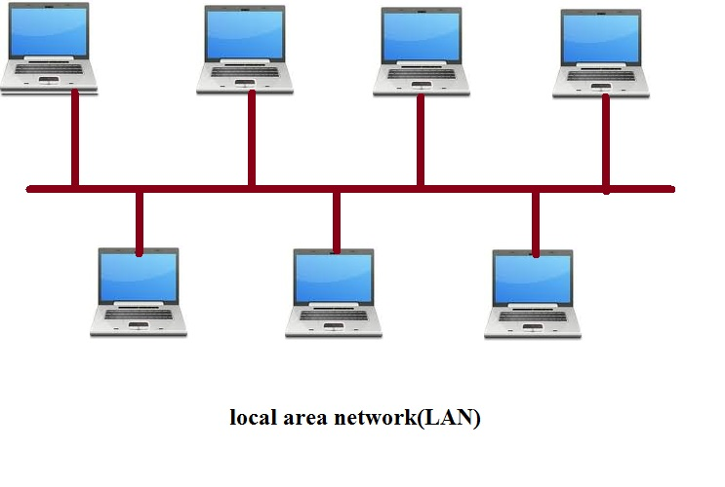
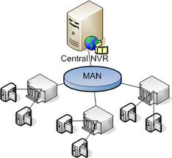
TYPES OF NETWORKS

Slide 7
LOCAL AREA NETWORK (LAN)
•Smallest network compared to the other two networks.
• The simplest form of LAN is to connect two computers together.
• LAN is operated within a limited physical area, such as at home, school, a single building or several buildings.
• A network which consists of less than 500 interconnected devices across several buildings, is still recognised as a LAN.

Slide 8
METROPOLITAN AREA NETWORK (MAN)
•‘Metropolitan' - describes important cities like New Delhi, Mumbai,Kolkata Chennai etc.
• Companies that have several branches within the Mumbai city such as banks, use a MAN.
• Can be a collection of several LANs within the same city.Man can be defined as a group of computers and network devices connected together.

Slide 9
WIDE AREA NETWORK (WAN)
The largest network of all network types. • Internet is the largest WAN in the world. WAN generally covers large distances such as states, countries or continents. • Eg: Local banks have always maintained their business online by connecting all computers of their branches in the countries. International banks also use WAN to connect their computers all over the world.
WAN is a group of MANs or LANs or the mixture of both networks.

Slide 10
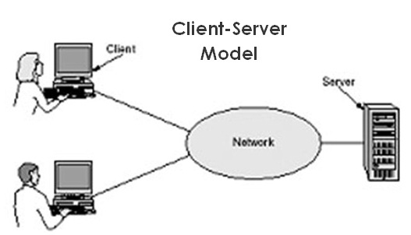
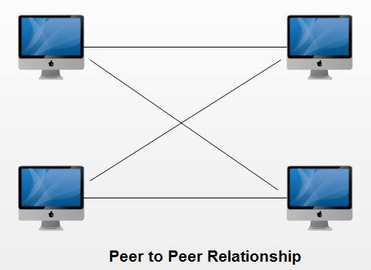
NETWORK ARCHITECTURE

Slide 11
CLIENT/SERVER NETWORK
• A client/server network is a network in which the shared files and applications are stored in the server but network users (clients) can still store files on their individual PCs.
• A server is a computer that shares information and resources with other computers on a network. • A client is a computer which requests services or files from a server computer

Slide 12
Peer-to-peer or P2P
It is a network with all the nodes acting as both servers and clients.
• A PC can access files located on another PC and can also provide files to other PCs.
• All computers in the peer-topeer network has equal responsibilities and capabilities to use the resources available on the network.
• With peer-to-peer network, no server is needed; each computer in the network is called a peer.

Slide 13
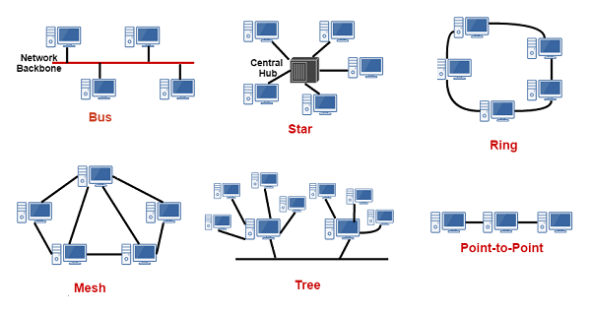
NETWORK TOPOLOGY
DIFFERENT TOPOLOGIES

Slide 14
Bus Topology
A bus topology consists of a single central cable to which all computers and other devices connect. A bus topology is also known as a bus network.
DESCRIPTION OF BUS TOPOLOGY
Very common in LAN.
• Must have a common backbone (the central cable) to connect all devices.
• All nodes share the backbone to communicate with each other on the network.

Slide 15
Ring Topology
A ring topology consists of all computers and other devices that are connected in a loop. Ring topology is also known as a ring network.
DESCRIPTION OF RING TOPOLOGY
• Can be found in LAN. • Each node directly connect to two neighbouring nodes.
• A server may exist in a ring network, but it will not connect to all the nodes in the network.
• The server, like other nodes, will only communicate to its two neighbouring nodes

Slide 16
Star Topology
A star topology consists of a central host which acts as the center, and all nodes connect to the host. A star topology is also known as star network.
DESCRIPTION OF STAR TOPOLOGY
• A star network is found in a Local Area Network setting.
• A star network must have a host which acts as the center.
• The host can be a server, hub or router.
• In a star network, every node will not connect to the neighbouring nodes.

Slide 17
Tree Topology
Tree topology is the combination of the bus and the star topology. The tree like structure allows you to have many servers on the network and you can branch out the network on many ways. Also known as hierarchical network.
DESCRIPTION OF RING TOPOLOGY
• Nodes of some devices are linked to a centrally located hub which is called the active hub.
• The active hub has a hardware device called the repeater.
• This strengthens the transmission and increase the travelling distance of a signal.

Slide 18
APPLICATIONS OF COMPUTER NETWORK
File sharing.
• Printer sharing.
• Communication and collaboration.
• Remote access.
• Data protection.
• Centralized Support and Administration

Slide 19
Thank you

